Slide 1
Predicting Employee Attrition using HR Dataset
Authors:
Kafuuma Henry - 2024/HD05/21926U
2. Kakungulu Birungi - 2024/HD05/21927U

Slide 2
Introduction
Employees are the backbone of the organization. Organization's performance is heavily based on the quality of the employees. Challenges that an organization has to face due employee attrition are:
Expensive in terms of both money and time to train new employees.
Loss of experienced employees
Impact in productivity
Impact profit

Slide 3
Background
Employees are the most valuable assets of an organization.
Therefore, it is indispensable to maintain a permanent and promising workforce
This study is an attempt to find out the causes of attrition from different dimensions.
Notes:
The dataset can be found here.

Slide 4
Problem Statement
Employee attrition is one of the major factors that affect overall business performance. Organizations incur huge costs in terms of lost productivity and expertise, recruitment as well as training costs. For this reason, they are struggling hard to find and extirpate the causes for high attrition. These causes may vary with industry and location.
This study aims at finding the causes of attrition in a reputed sales organization with its presence in all major cities in India

Slide 5
ML Research Objectives
The goal of the study is to model and predict probability of employee attrition based on certain features.
Understand what factors cause attrition.
Identify what needs to be changed in order to reduce employee turnover

Slide 6
Research Questions
What factors are contributing more to employee attrition?
What type of measures should the company take in order to retain their employees?
Which business unit faces the attrition problem?

Slide 7
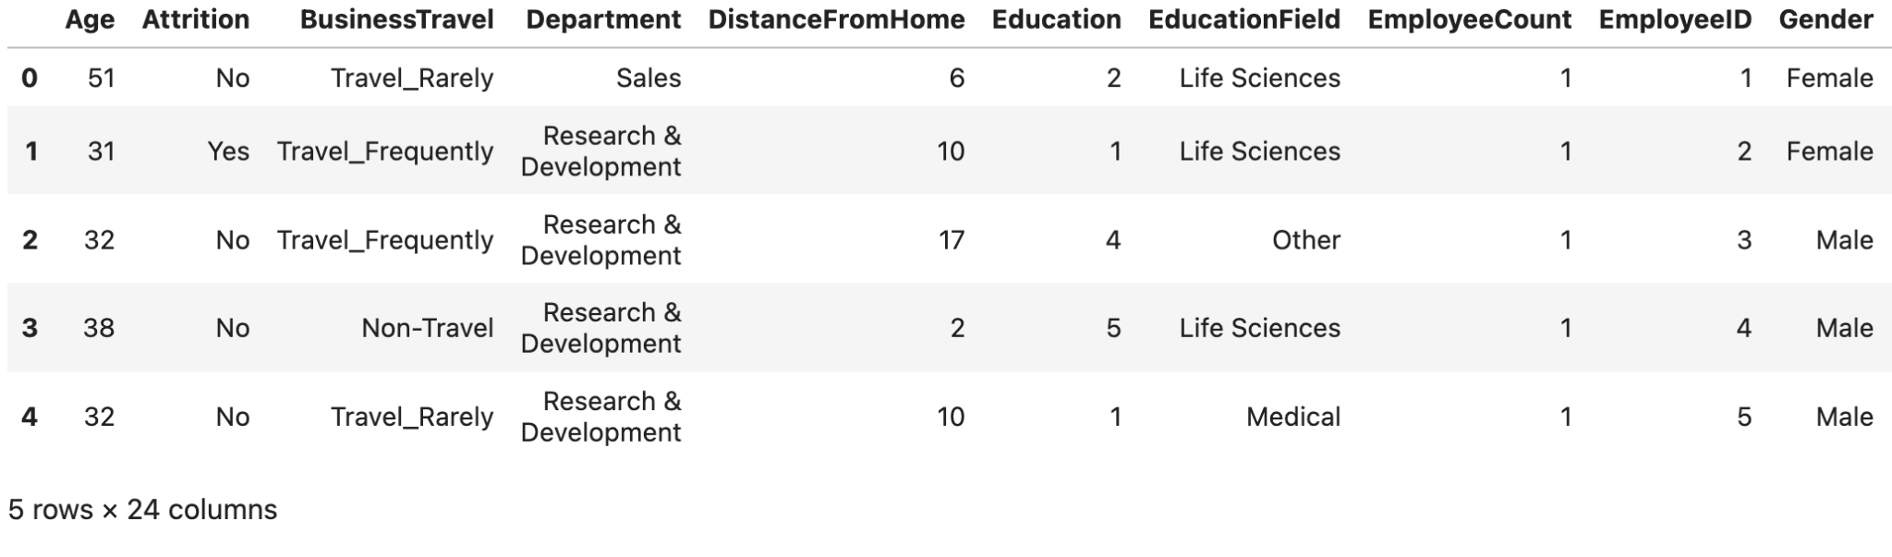
Dataset Description
This is the dataset of a large company, which has around 4000 employees. Every year, around 15% of its employees leave the company and need to be replaced with the talent pool available in the job market
The Dataset has 24 features an 4410 rowa

Slide 8
Methodology
Dataset Identification
Exploratory Data Analysis
Data Processing
Feature Selection
Training the model
Analysis
Conclusion

Slide 9
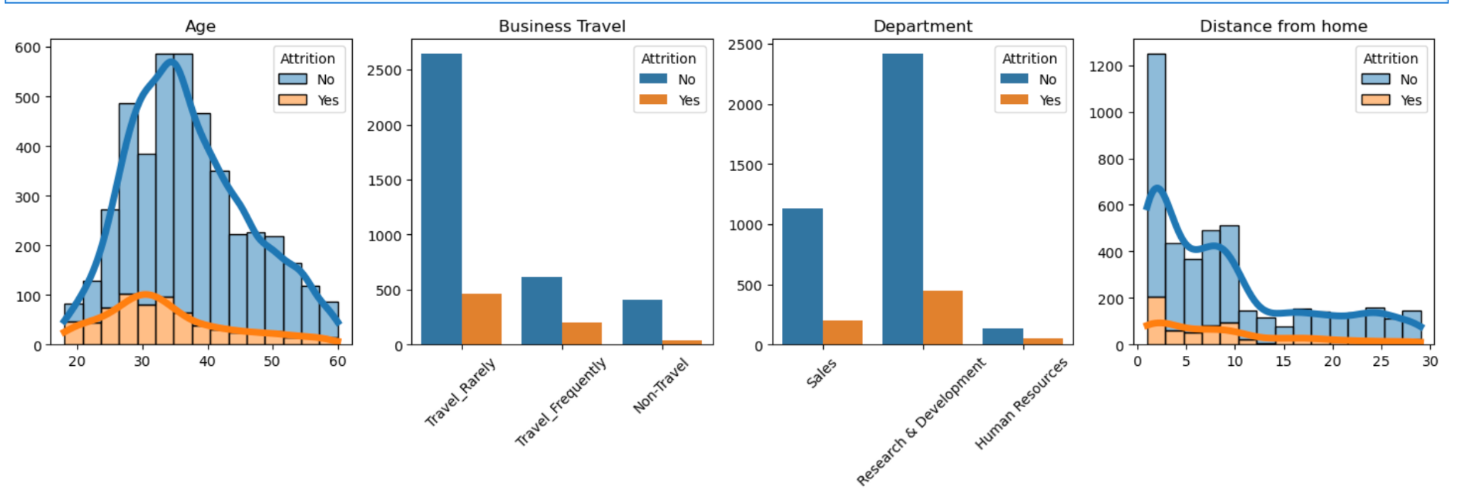
Exploratory Data Analysis (EDA)

Slide 10
EDA Insights Cont…
From EDA we certainly want to take into account (since they were visually influential):
Business Travel
Department
Education Field
Marital Status

Slide 11
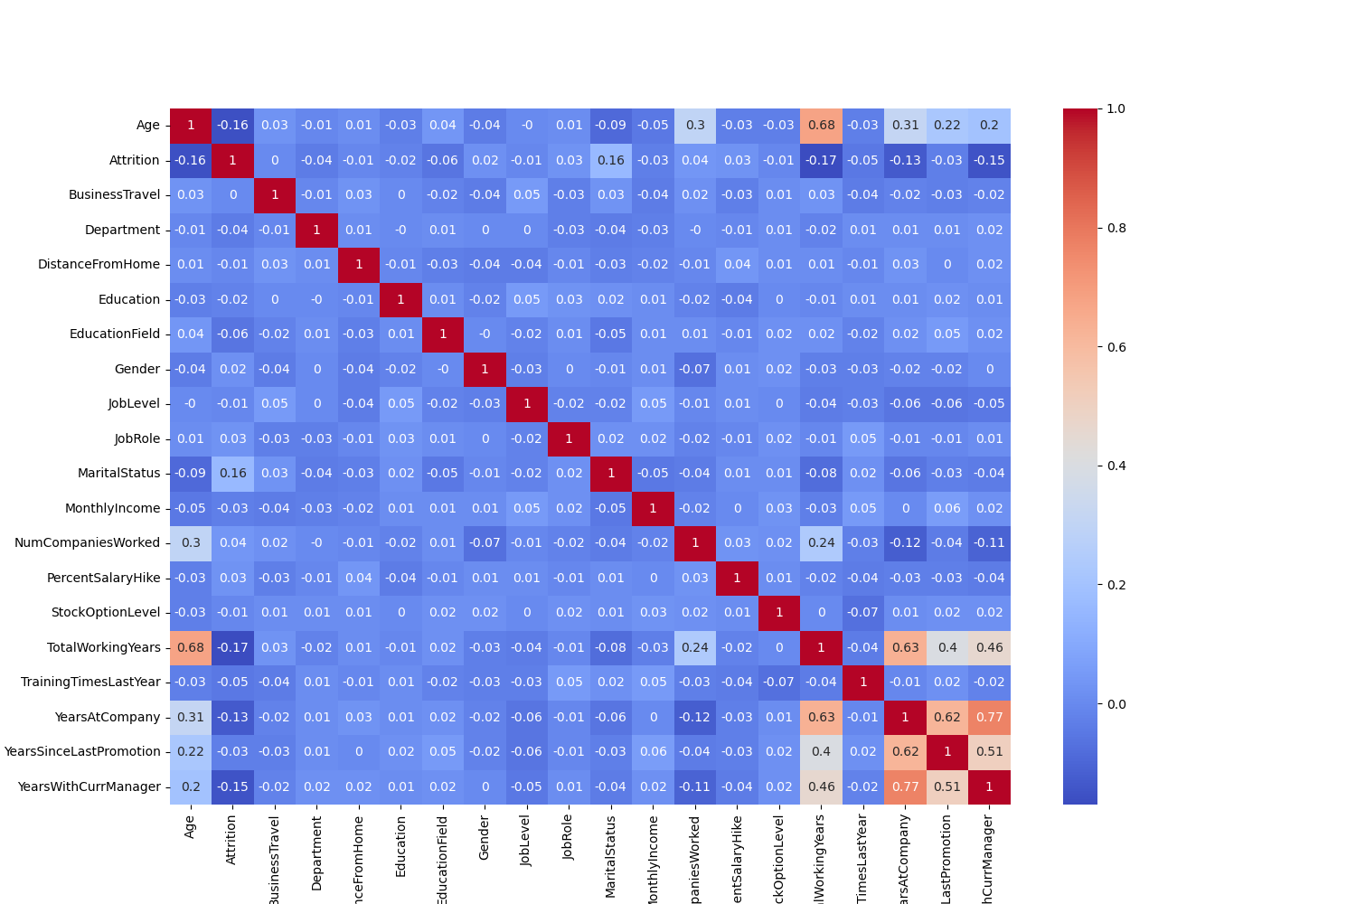
EDA Insights Cont…

Slide 12
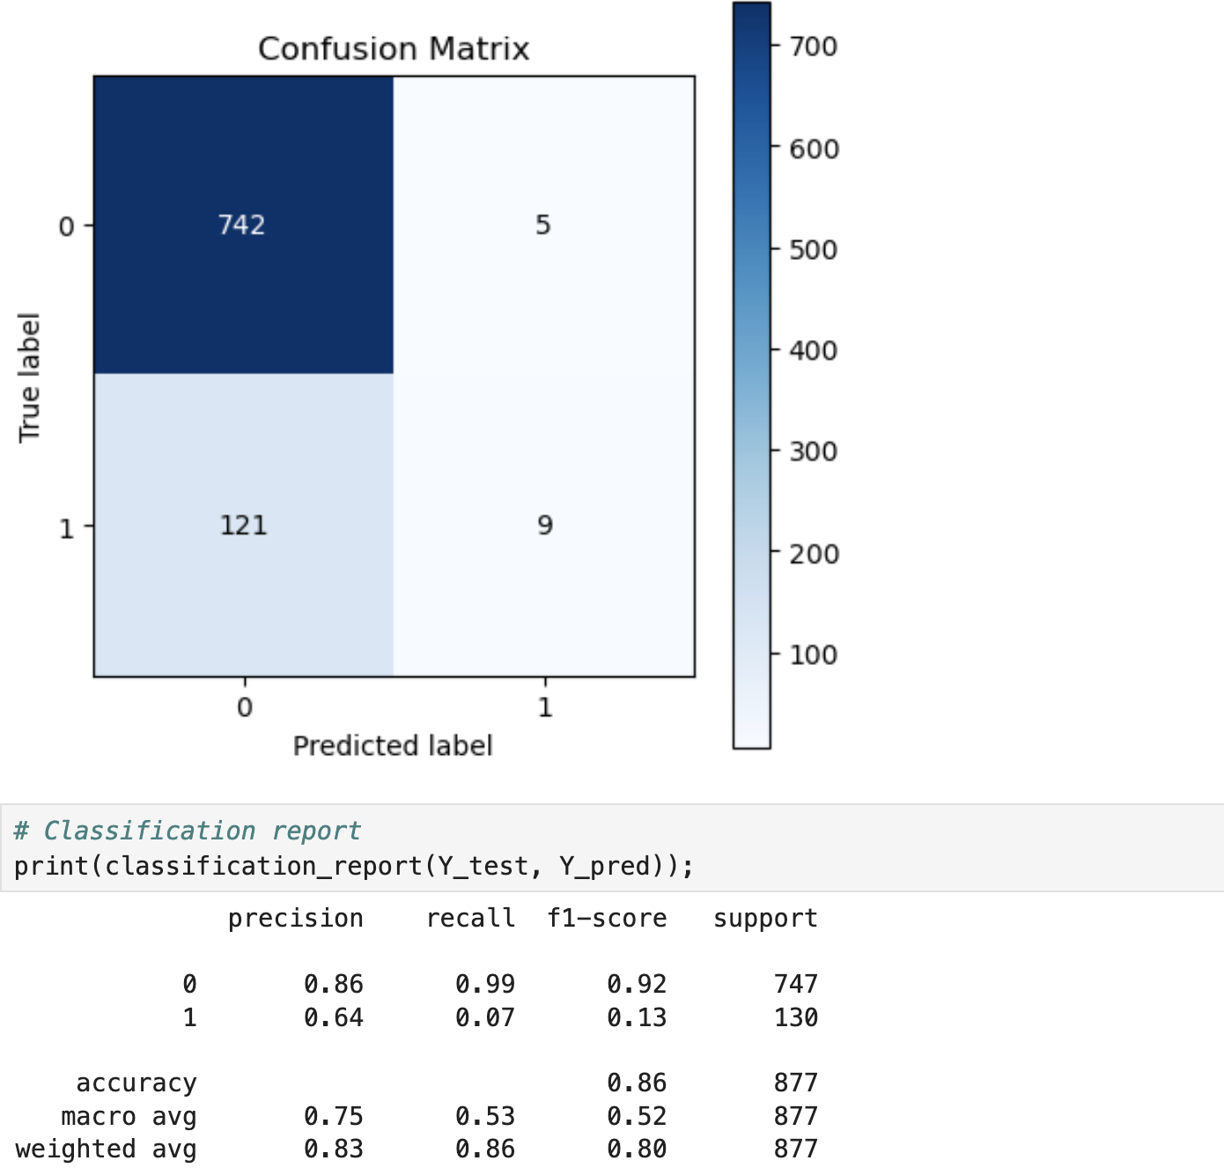
Project ResultsTrain Model FULL-set of features
Notes:
Link: https://sorry.vse.cz/~berka/challenge/PAST/

Slide 13
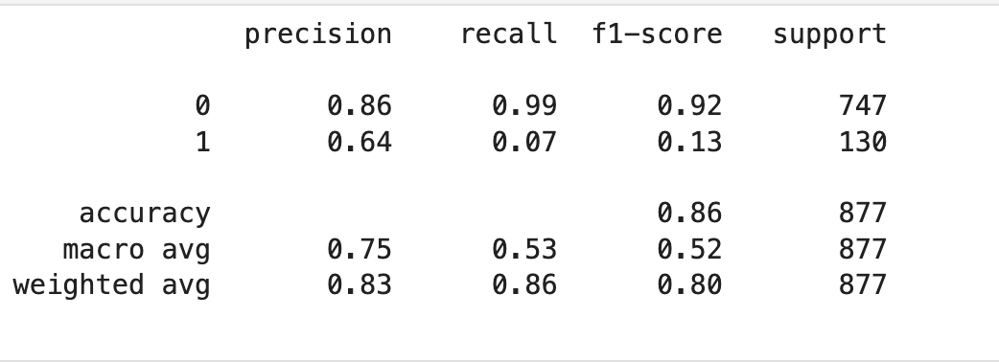
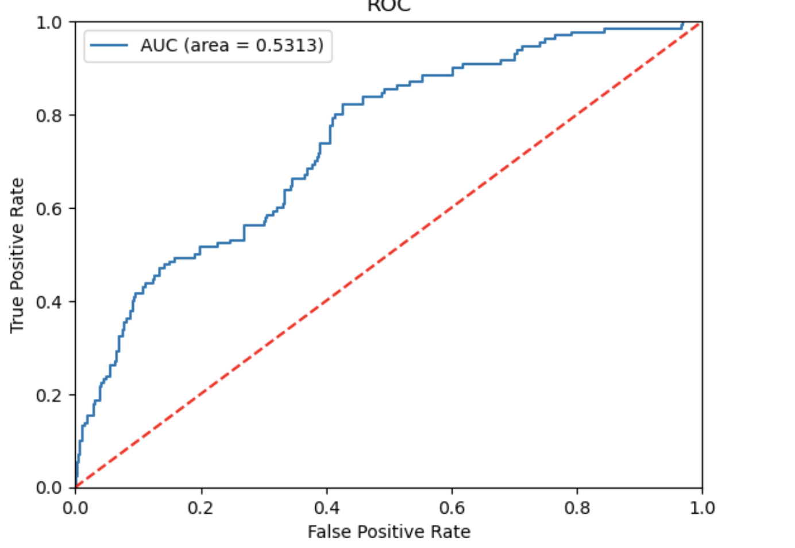
Cont’
Notes:
Link: https://www.kaggle.com/datasets/santoshd3/bank-customers

Slide 14
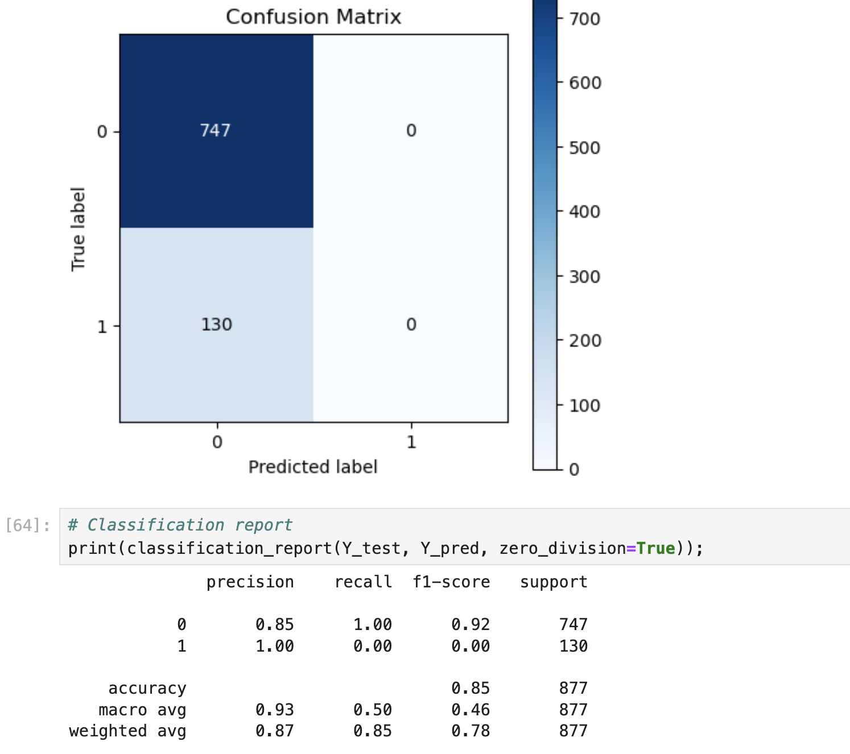
Cont .. Reduced set of features
Notes:
Link: https://www.kaggle.com/datasets/santoshd3/bank-customers

Slide 15
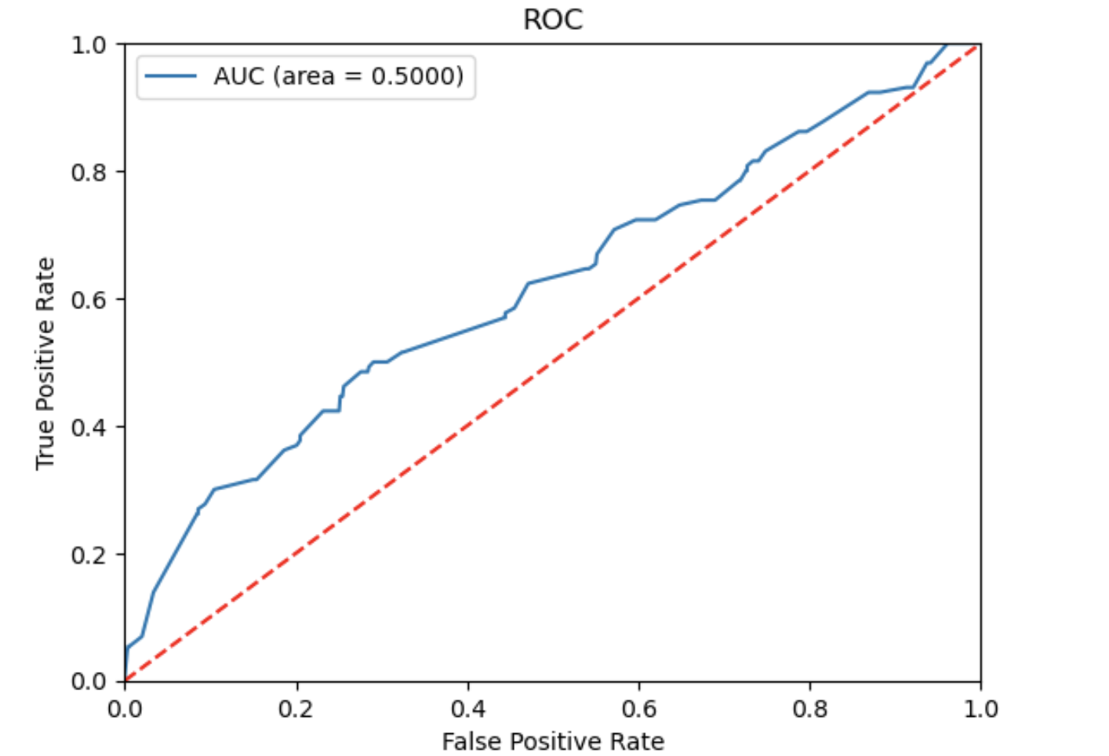
Cont’
Notes:
Link: https://www.kaggle.com/datasets/santoshd3/bank-customers

Slide 16
Conclusion
Business Travel, Department, Education level and Marital Status of the Employee are the features that affect Employee attrition more than others.
However Logistics regression model performs better with a full set of features.

Slide 17
Future Work
Consider Other Classification Models like Decision Trees and do a comparison.
Deploy the model and expose UI interface.

